Slide 1

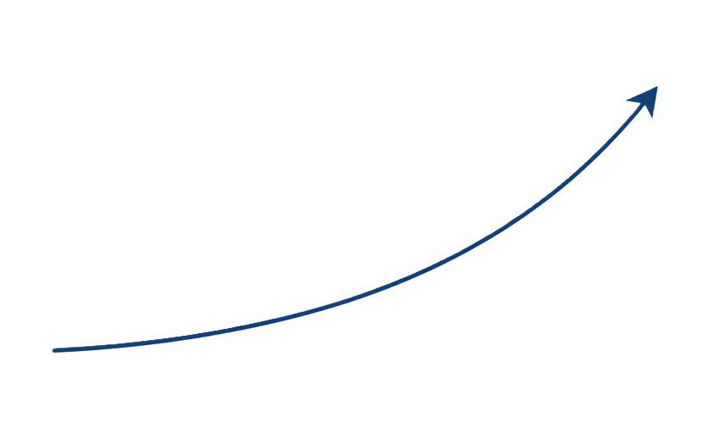
WHICH STARTUPS RAISE AGAIN?
Picking seed-stage startups that go on to secure more funding
Presenter: Meqdad Muhana
July 12, 2026

Slide 2




HOW VENTURE CAPITAL MAKES MONEY
VC firms invest small "seed" cheques in very young startups
Firms profit only if a startup raises AGAIN and grows
A startup that raises seed and never raises again has "stalled"

Slide 3



THE FIRM'S PROBLEM
The firm keeps backing seed startups that stall
It has $10M to invest and wants to stop guessing
"Which seed startups have historically gone on to raise again?"

Slide 4




THE DATA
~49,000 companies worldwide (Crunchbase)
Cleaned the data, focused on the 13,839 that raised seed
"Success" = raised more than one funding round
Built in Python.

Slide 5





WHAT WE'LL COVER
01
02
03
04
The baseline problem
Industry analysis
Geography & Location
Timing & Strategy

Slide 6

THE BASELINE
41%
Of startups raise again
Nearly 6 in 10 stall

Slide 7
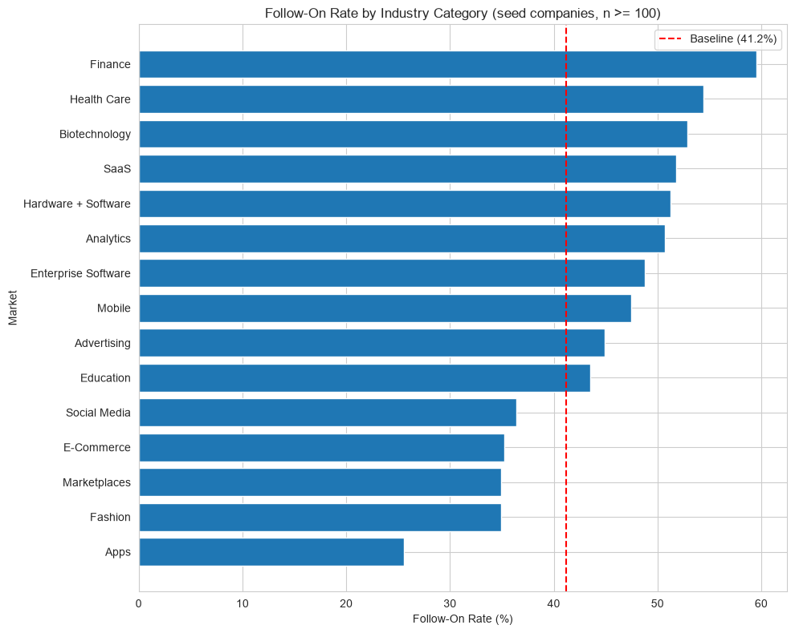


INDUSTRY IS THE BIGGEST LEVER
Best Performers
Finance 60%, Health Care 54%, Biotech 53%
Worst Performers
Apps 26%, Fashion & E-Commerce ~35%

Slide 8
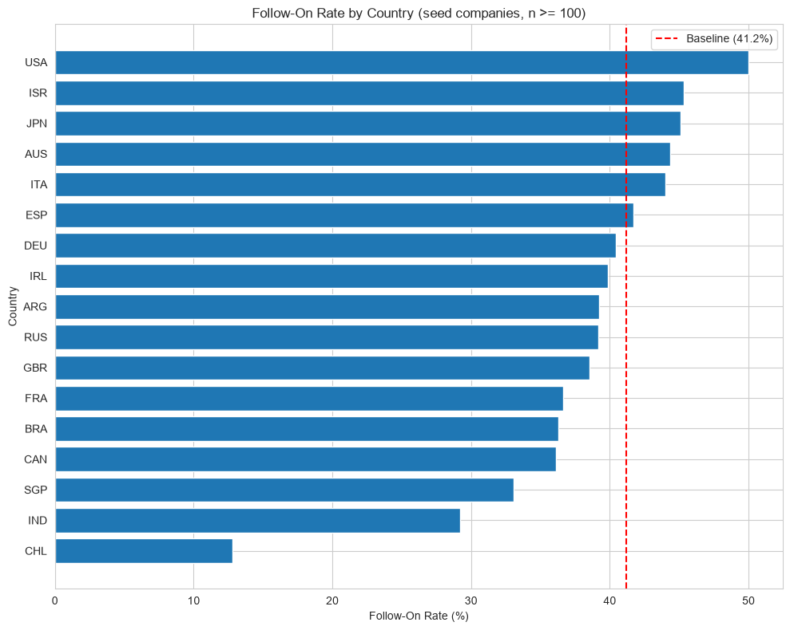
LOCATION MATTERS TOO
USA Leads
50% follow-on rate and represents over half the global data
Strong Ecosystems
Japan also beat the average at 45%
Lagging Regions
Chile (13%) and India (29%) lag far behind the baseline

Slide 9




HOW LONG TO WAIT BEFORE GIVING UP
~10 Months
24 Months
The 2-Year Rule
The typical follow-on round comes in this timeframe.
90% of winners raise again within 2 years.
Silent past 2 years → treat as stalled.

Slide 10

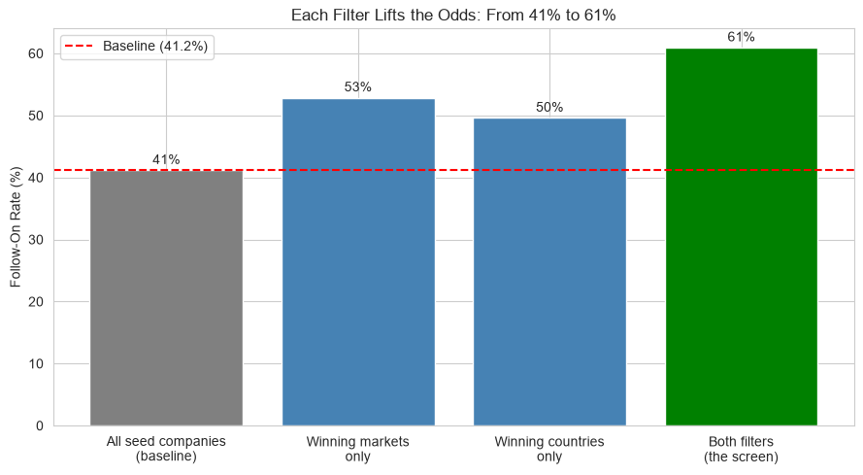
PUTTING THE FILTERS TOGETHER
Screening by winning industry + geography lifts the hit rate from 41% to 61%

Slide 11





WHAT TO DO WITH THE $10M
Sector Focus
Geography
Favor Finance, Health Care, Biotech, and enterprise software
Weight toward the US and other strong ecosystems like Japan
Timing Rule
Projected Impact
Drop investments that don't raise again within 2 years
~7 more advancing startups from the same $10M (~48% better)
THANK YOU

